Slide 1
2Market Marketing Data Analytics Project
Project Aim:
Know Our Customers
Best Selling Products
Best Advertising Channel

Slide 2
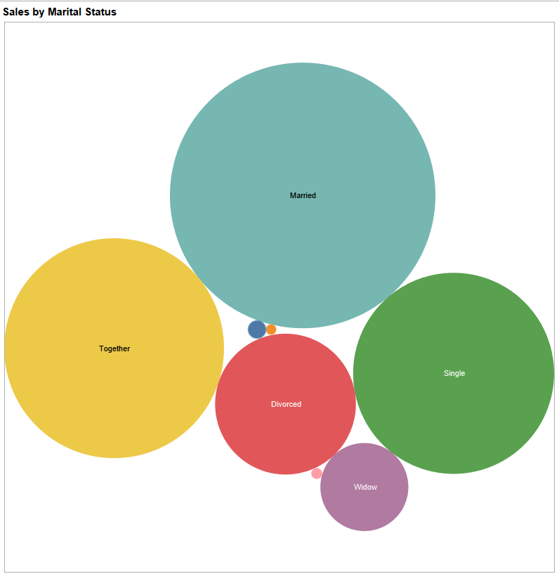
Who spends the most?
Our Customers
Married people spend the most
Followed by Together, Single and Divorced respectively

Slide 3
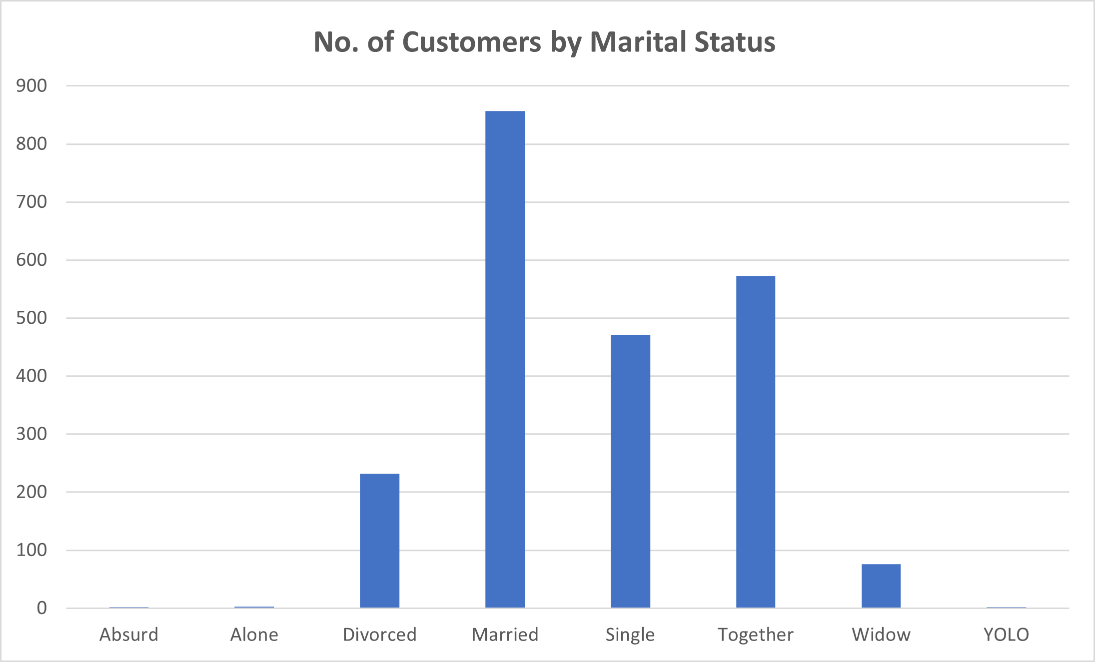
Number of Customer by Marital Status
‘Married’ customers make just under 40% of total customers
Followed again by Together, Single and Divorced

Slide 4
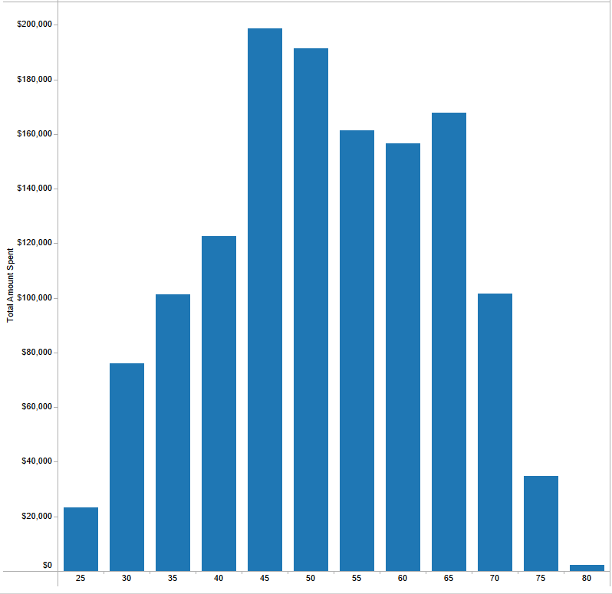
Spend by Age
45-54 years old are our favorite!

Slide 5
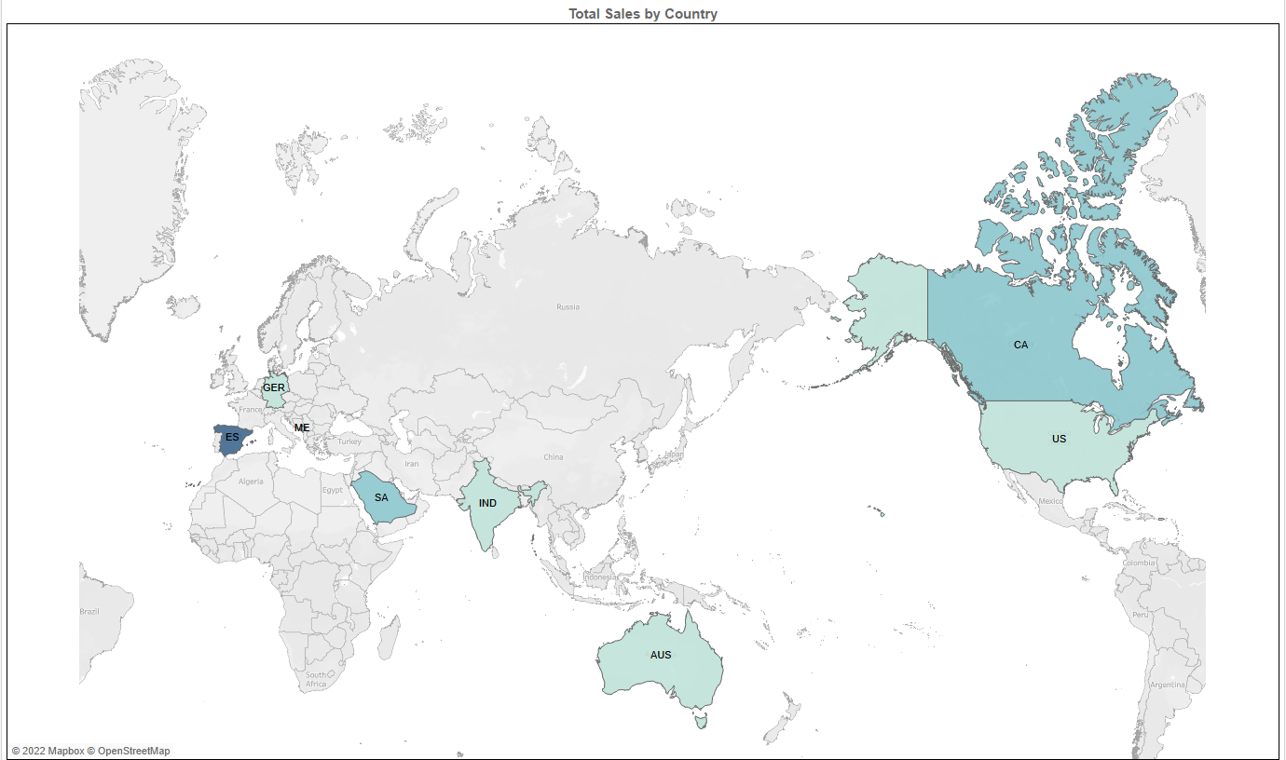
Where are our Customers based?
Spain gives us the highest sales turnover
Montenegro the least

Slide 6
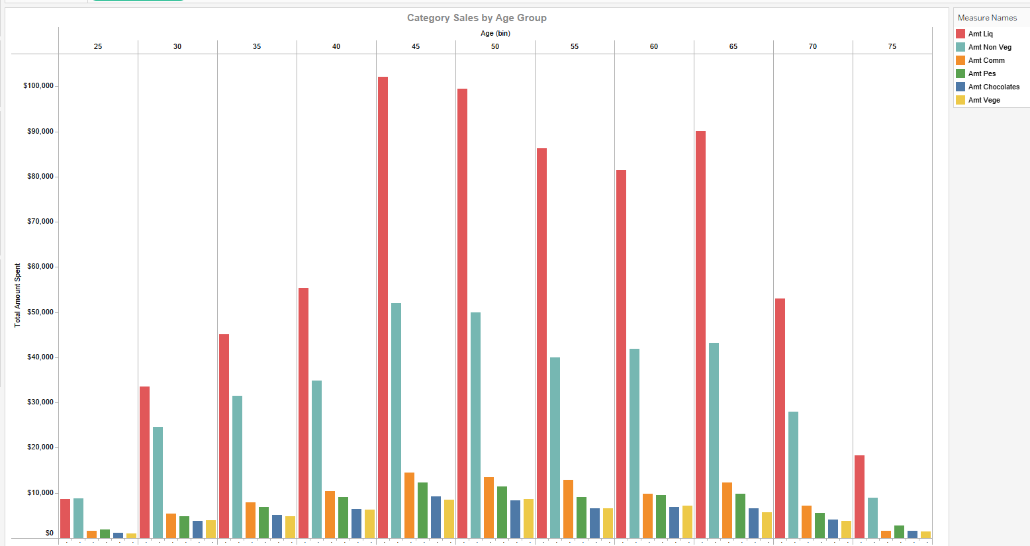
Which product group our different aged customers like?
Product Sales
‘Liquor’ rules by sales turnover!

Slide 7
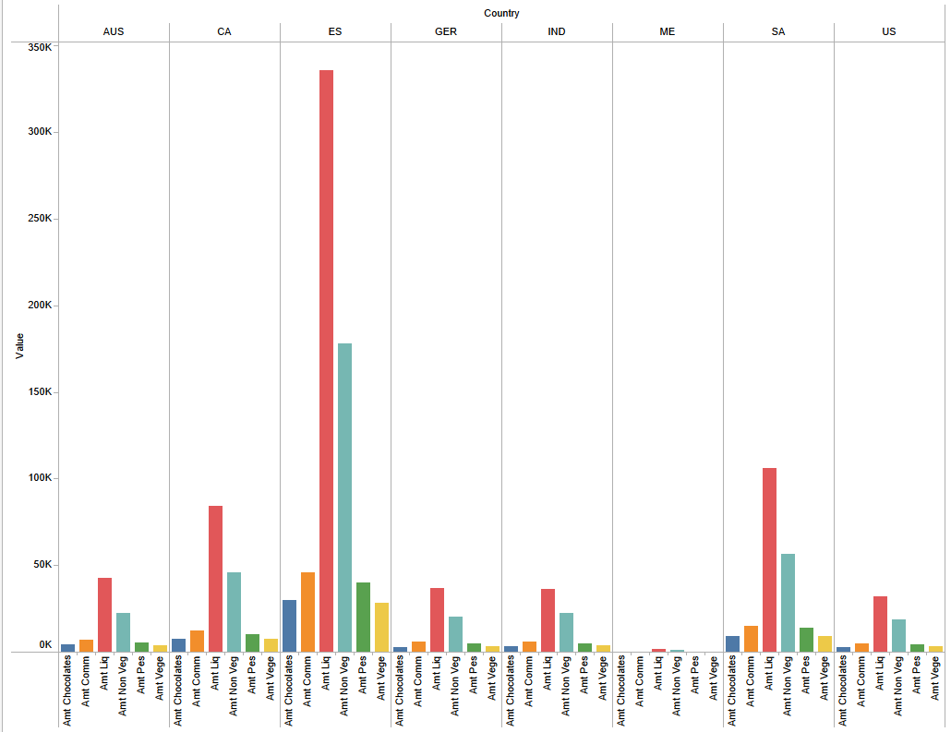
Does demand differ in different countries?
Everyone loves Liquor!
Non-Veg is the 2nd Best

Slide 8
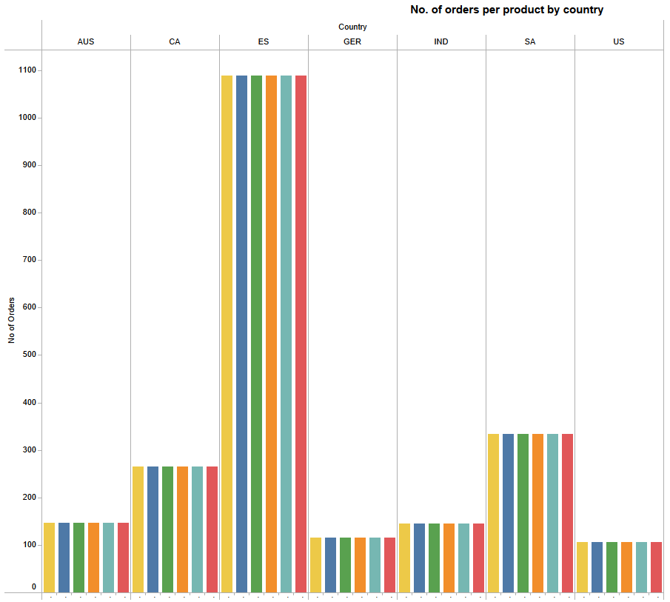
Do we get more orders for Liquor?
All SAME???
Average Unit Price?

Slide 9
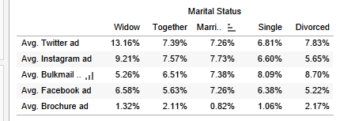
Lead Conversion by Marital Status
Best Advertising Channel
Widows prefer Twitter
Together and Married like Instagram
Single and Divorced prefer Bulk mail

Slide 10
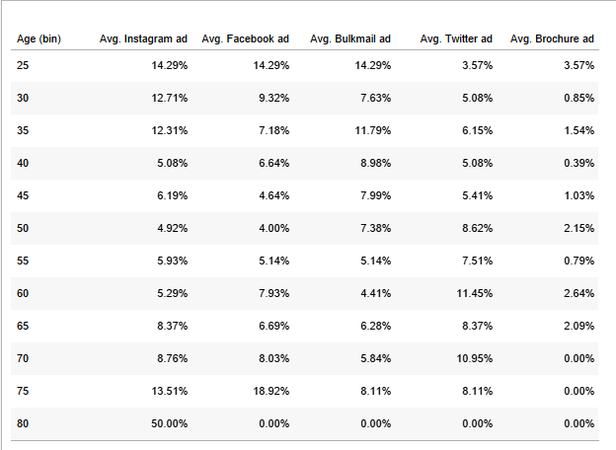
Lead Conversion by Age
5 age groups prefer Instagram
2 votes for Facebook
3 age groups like Bulk mail
5 votes for Twitter as well
25-29 years old like Insta, FB and Bulk mail equally

Slide 11
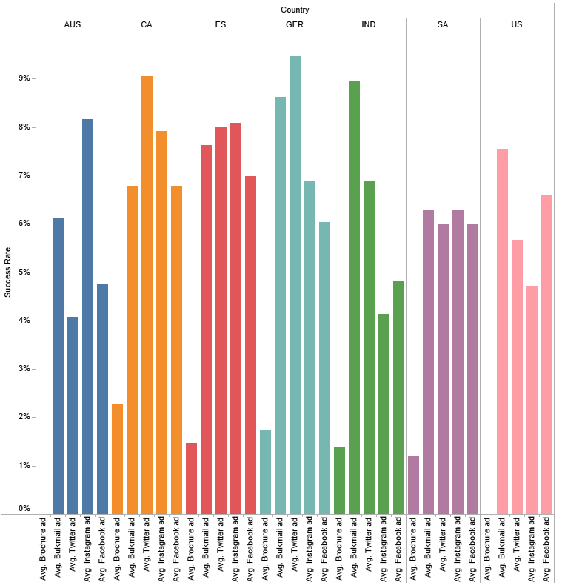
Lead Conversion by Country
Australia and Spain like Instagram
Canada and Germany Tweet a lot
Bulk mail is popular in India and US
Saudi Arabia is partial towards Brochure channel

Slide 12
Conclusion
Different advertising channels do well in different countries for different customers based on marital status and age group.
Every customer buys every product group product with every order placed.
Age group between 45-65 spend the most with us.

Slide 13
QUESTIONS??

